Slide 1
Gesture Recognition and Integration
A project by
Neel & Nisarg
* See slide notes for page directions
Notes:
When listing all project collaborators, either use commas or bullets

Slide 2
Outline
Camera
Pre-Processing
Feature Extraction Algorithms
Realtime Classification
Output
Notes:
Think about the questions/situations listed above and answer them.
Can you think of anything else in regards to transportation that you would like to add?

Slide 3
Hand Gesture Detection and Recognition
Detection
Presence of hand
Still or moving images
Variation in image plane and pose
Rotation translation and scaling of pose
Notes:
Insert a map of your colony (draw it, ink it, or create it in PPT- be creative!)
Insert -> Pictures for photos
Draw for digital inking
Insert -> Shapes if you want to create it in PPT
All mountains, towns/villages, bodies of water/waterways, landmarks, etc. should be clearly labeled

Slide 4
Recognition
Capture (Detect & Recognize)
Compute (Interpret)
Classify

Slide 5
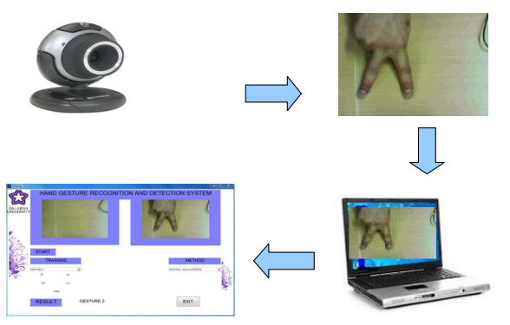
Recognition
Notes:
Use the SmartArt to determine the flow of government/leadership:
Who leads the colony (executive)? What is that person/are those people’s duties?
Who makes the rules (legislature)?
Who ensures the rules are followed (judicial)?
Are there any other branches of government? If so, who are they and what is their job?
To add more shapes, click on the left shape first, then on SmartArt Tools -> Design -> Add Shape After
Do the same for the shape to the right
Feel free to rename the branches!

Slide 6
Rules & Laws
1
2
3
Remove Background
Convert to GrayScale
Row Vector
4
5
Neural Vector
Recognition
Notes:
What are the rules and laws of your colony? Think about what helps the colonists stay safe and maintain a healthy, happy colony.
In each shape…
Name the rule/law
Describe why it’s important for the colony/colonists
Explain the consequences for not following this rule/law
To add more shapes, click on the last shape, then on SmartArt Tools -> Design -> Add Shape After

Slide 7
Datasets
https://www.kaggle.com/datasets/gti-upm/leapgestrecog
https://developer.qualcomm.com/software/ai-datasets/jester
Notes:
What is the name of your colony song?
Write lyrics to the song and, if you are feeling creative, use a computer program or instruments to create the music that goes along with it!
To insert an audio file, click on Recording -> Audio -> Audio on My PC and choose your file

Slide 8
Economy & Trade
With, from, or to whom do the colonists trade, buy, or sell?
Talk about how colonists purchase items - do they use money or trade items?
If it is a trade-based system, how do they determine what trades are fair or even?
Why did they choose to do or not do business with other colonies?
Are there natural barriers that prevent or limit business with other colonies?
What are other barriers to or benefits from trading with other colonies?
If they use money, what does their money look like?
Do other colonies use the same money?
If not, how do they make a fair exchange (think of exchange rates/systems).
Does your colony have something the other colony needs or vice versa?
Notes:
Think about the questions listed above and answer them.
Can you think of anything else in regards to economy and trade that you would like to add?

Slide 9
Algorithms
 | Row Vector Algorithm
 | Edging And Row Vector Passing Algorithm
 | Mean and Standard Deviation of Edged Image
 | Diagonal Sum Algorithm
Notes:
*OPTIONAL SLIDE* If you are interested in learning more about social groups, look up the caste or class system.

Slide 10
Colony Symbols
Colony Flower
Colony Tree
Colony Bird
Colony Famous Person
Colony Flag
Notes:
Have fun with this slide! Use drawing paper or inking to create your colony’s flag, flower, bird, tree, and its most famous person!
If you use drawing paper, take a photo and insert the image
If you choose to use digital inking, click on the Draw tab and ink away!

Slide 11
Customize this Template
Template Editing Instructions and Feedback

